Slide 1
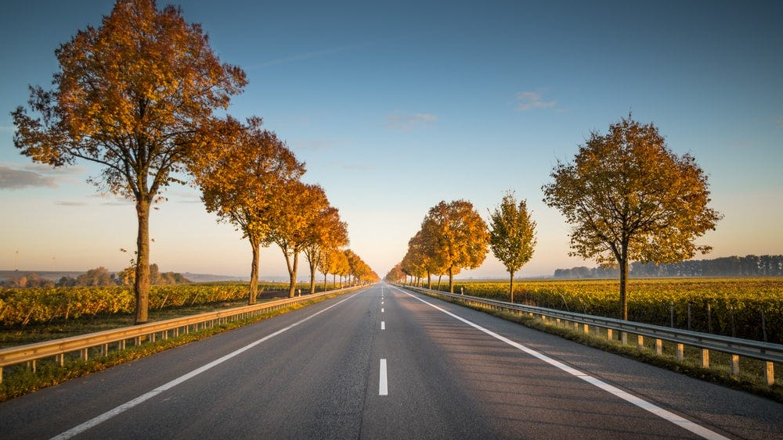
Road Lane Detection In Autonomous Vehicles
Done by:-
V.MANOKARTHIKREEDY - 192225077
B.SAI HETHWICK - 192125077
SD.SALARUDDIN - 192225087

Slide 2
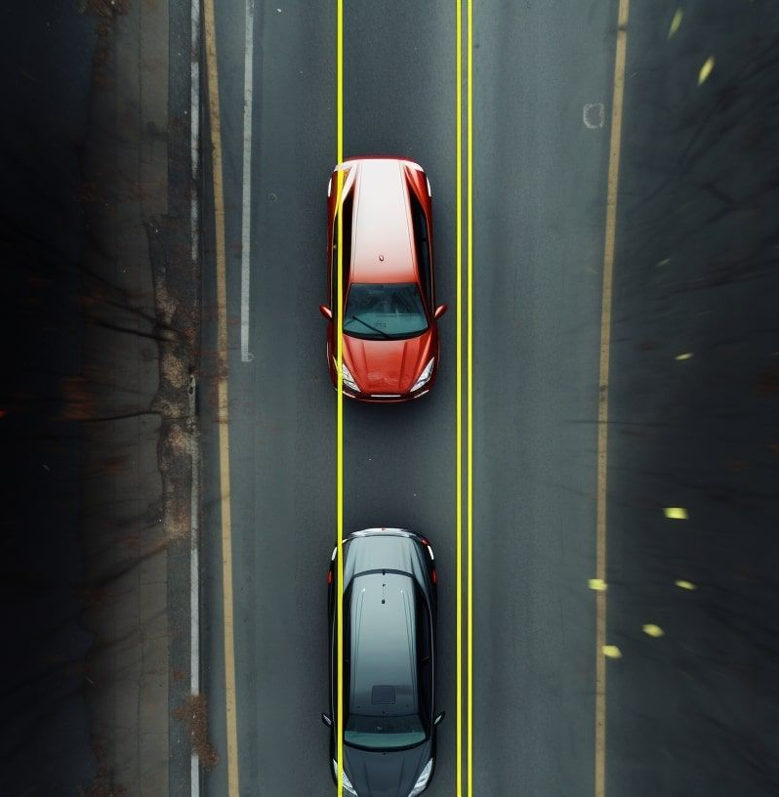
Abstract:
This project aims to develop a lane detection system for autonomous vehicles using computer vision techniques.
It processes real-time video streams from onboard cameras to identify lane markings, aiding in vehicle control and navigation.
The approach involves data collection, preprocessing, and exploring various computer vision algorithms including traditional methods like Canny edge detection and Hough transform, as well as deep learning techniques like CNNs.
Feature extraction, localization, and tracking algorithms are used to estimate lane position and orientation. Integration with the vehicle's control system provides real-time feedback for tasks such as steering and lane-keeping.
Evaluation metrics include accuracy, precision, recall, and F1 score, tested in diverse environmental conditions.
The project aims to enhance autonomous vehicle safety and navigation, with continuous improvement based on real-world feedback.

Slide 3
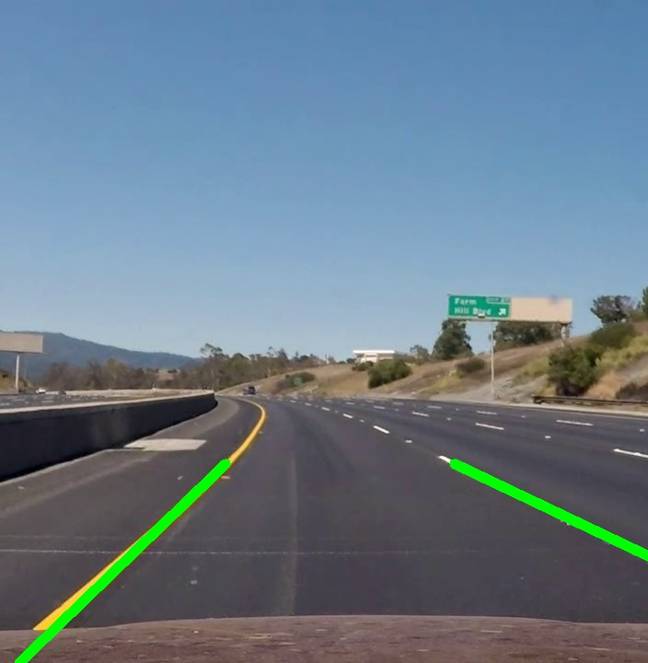
Introduction:
Autonomous vehicles are poised to revolutionise transportation, offering safe and efficient mobility solutions. Central to their operation is the ability to perceive and navigate roadways autonomously. Road lane detection is crucial for this, providing vital information for safe navigation.
This project aims to develop a robust road lane detection system using computer vision techniques tailored for autonomous vehicles. By analysing real-time video streams from onboard cameras, the system identifies lane markings to aid in vehicle control and navigation.
This introduction outlines the project's goals and emphasises the importance of developing a reliable lane detection system for enhancing autonomous vehicle safety and navigation. It briefly explains the methodology, including data collection, preprocessing, algorithm exploration, and integration with the vehicle's control system.
In summary, this project aims to contribute to the advancement of autonomous vehicle technology by addressing the critical task of road lane detection, thereby improving the safety and efficiency of autonomous driving.

Slide 4
Materials and Methods:
Camera : Use to capture the Video feed of the road.
Computer vision Libraries: Use opencv to process the video frames.
Prepocessing: Prepocess the video frames to enhance the road lines is visibility.
ROI : Define a region of interest the focus on the area where road lines are expected to present.
Line detection algorithm: Implement probabilistic hough transform to straight-line detection.
Filtering and Smoothing: Filter and Smooth the detected lines to remove noise and ensure smoother output.
Visualisation: Visualise detected lines on the Video frames to show the detected road lines.
Evaluation: Evaluate the performance of algorithm using matrices like accuracy precision and F1 - Score.
Optimisation: Optimise the speed and accuracy based on the specific requirements.

Slide 5
Discussion:
Lane detection is vital for autonomous vehicles as it enables them to navigate safely and effectively without human intervention.
The challenges in lane detection include varying road conditions such as different lighting and weather conditions, as well as diverse road markings.
Traditional computer vision techniques like Canny edge detection and Hough transform offer simplicity and efficiency but may struggle with accuracy and robustness in complex scenarios.
Feature extraction involves identifying relevant lane markings in images using techniques like edge detection and gradient analysis.
The lane detection system is integrated with the vehicle's control system to provide real-time feedback for tasks such as steering and lane-keeping assistance.
Evaluation metrics such as accuracy, precision, recall, and F1 score are used to assess the performance of the lane detection system.
Real-world testing and validation are crucial to assess the reliability and effectiveness of the lane detection system under diverse conditions.

Slide 6
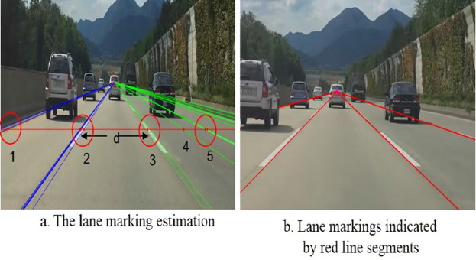
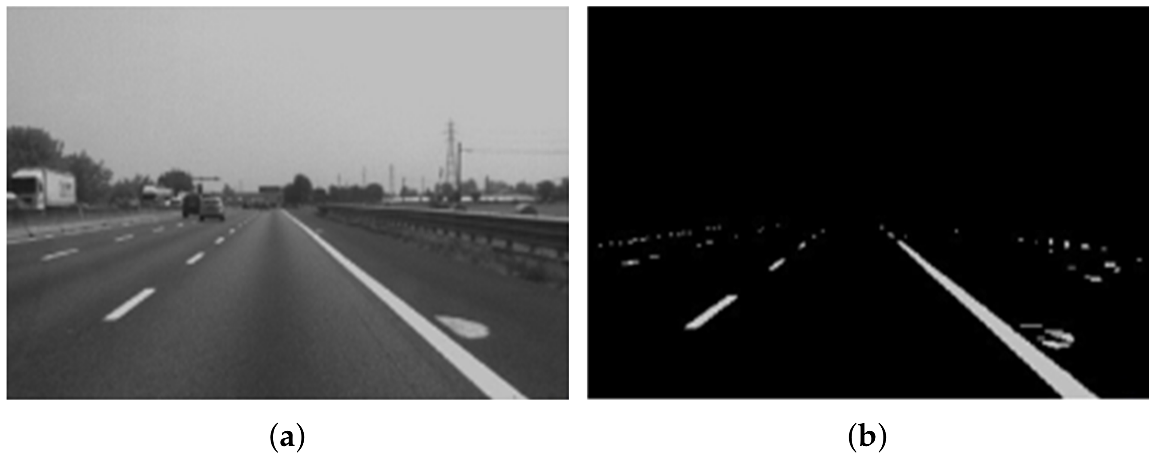
Results:
Self-driving cars are speculated to worsen air pollution, noise pollution, and sedentary lifestyles, to increase productivity and housing affordability, reclaim land used for parking, cause greater energy use, traffic congestion and sprawl.
The Lane Detection subsystem outputs the 7 most viable lane markings. In many applications, we are most interested in the lane markings that contain the lane in which the vehicle is driving.
Thus, the common objective of any model designed for lane line detection and/or lane line exit point notification is to determine the trajectory of the road lane with accuracy, efficiency and in real time.

Slide 7
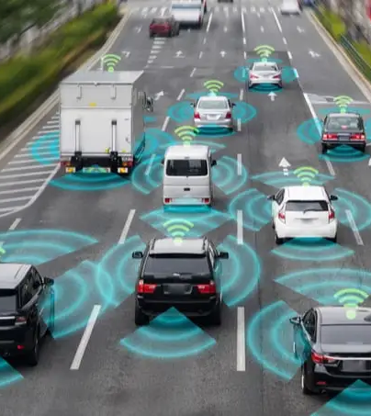
Conclusion:
To achieve edge detection, we used the OpenCV library and algorithms like the Canny Function. Then we created
a zero-intensity mask and mapped our region of interest using the bitwise approach. The Hough Transform
method was then used to detect the straight lines in the image and identify the lane lines. We utilized polar
coordinates since Cartesian coordinates could not give an adequate slope for vertical and horizontal lines. Finally,
we merged the original image with our zero-intensity image to show lane lines.

Slide 8
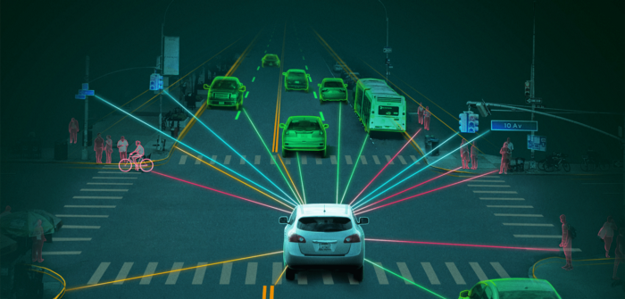
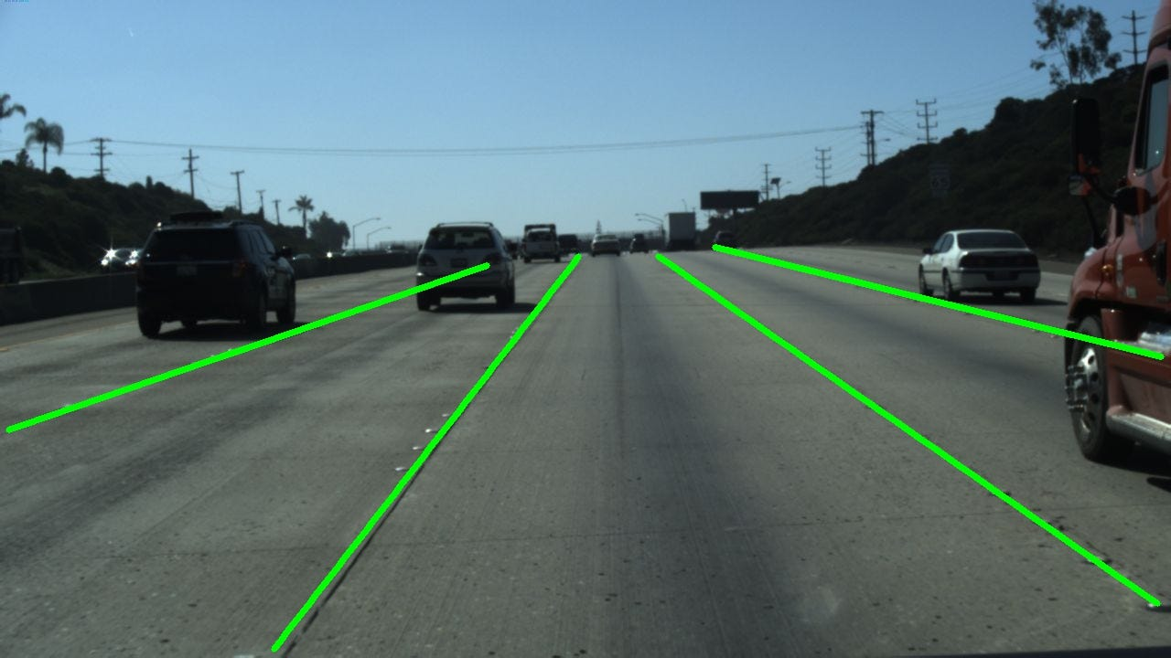
Scope:
Because we use modular implementation, updating algorithms is simple, and work on the model can be continued
in the future. We insert the model's pickle file into the relevant locations, which can then be simply transferred
to goods. As a result, compiling the full big code might be avoided easily. We can also enhance the idea by creating
a new future in which the road can be identified in the dark, or at night. In daylight, the color recognition and
selection process are highly effective. Adding shadows will make things a little noisier, but it won't be as rigorous
as driving at night or in low light (e.g., heavy fog). And this research can only recognize lanes on bitumen roads,
not on the loamy soil roads that are ubiquitous in Indian villages. As a result, this project can be improved to
detect and avoid accidents on loamy soil roads found in communities.

Slide 9
Reference:
Shopa, P., N. Sumetha and P.S.K Pathra. “Traffic sign detection and recognition using OpenCV",International Conference on Information Communication and Embedded Systems (ICICES2014), 2014
“Segnet: A deep convolutional encoder-decoder architecture for robust semantic pixelwise labelling,” arXiv preprint arXiv:1505.07293, 2015
M.Cordts,M. Omran,S.Ramos, T.Rehfeld,M. Enzweiler, R.Benenson,U. Franke,S.Roth, and B.Schiele, “The cityscapes dataset for semantic urban scene understanding,” in Proc. of the IEEE Conference on Computer Vision and Pattern Recognition (CVPR), 2016
K. He, X. Zhang, S. Ren, and J. Sun, “Deep residual learning for image recognition,” arXiv preprint arXiv:1512.03385, 2015
Zheng, S. Jayasumana, B. Romera-Paredes, V. Vineet, Z. Su, D. Du, C. Huang, And P.H Torr, “A Layered Approach To Robust Lane Detection At Night.” 2015, pp. 1529–1537

Slide 10


